Slide 1
SITA1503
FOG AND CLOUD COMPUTING
Unit 1

Slide 2
UNIT 1 UNDERSTANDING CLOUD COMPUTING
Basic Concepts and Terminology - Cloud Computing Architectural Framework - Types of Clouds - pros and cons of cloud computing – Cloud Characteristics - difference between web 2.0 and cloud - key challenges in cloud computing - Major Cloud players - Virtualization in Cloud Computing - Parallelization in Cloud Computing - cloud resource management – Cloud Enabling Technology.

Slide 3
UNIT 1 UNDERSTANDING CLOUD COMPUTING
History of Cloud computing
Cloud Computing Architectural Framework
Types of Clouds
pros and cons of cloud computing
difference between web 2.0 and cloud
key challenges in cloud computing
Major Cloud players
Cloud Deployment Models
Virtualization in Cloud Computing
types of virtualization
Parallelization in Cloud Computing
cloud resource management
dynamic resource allocation
Optimal allocation of cloud models.

Slide 4
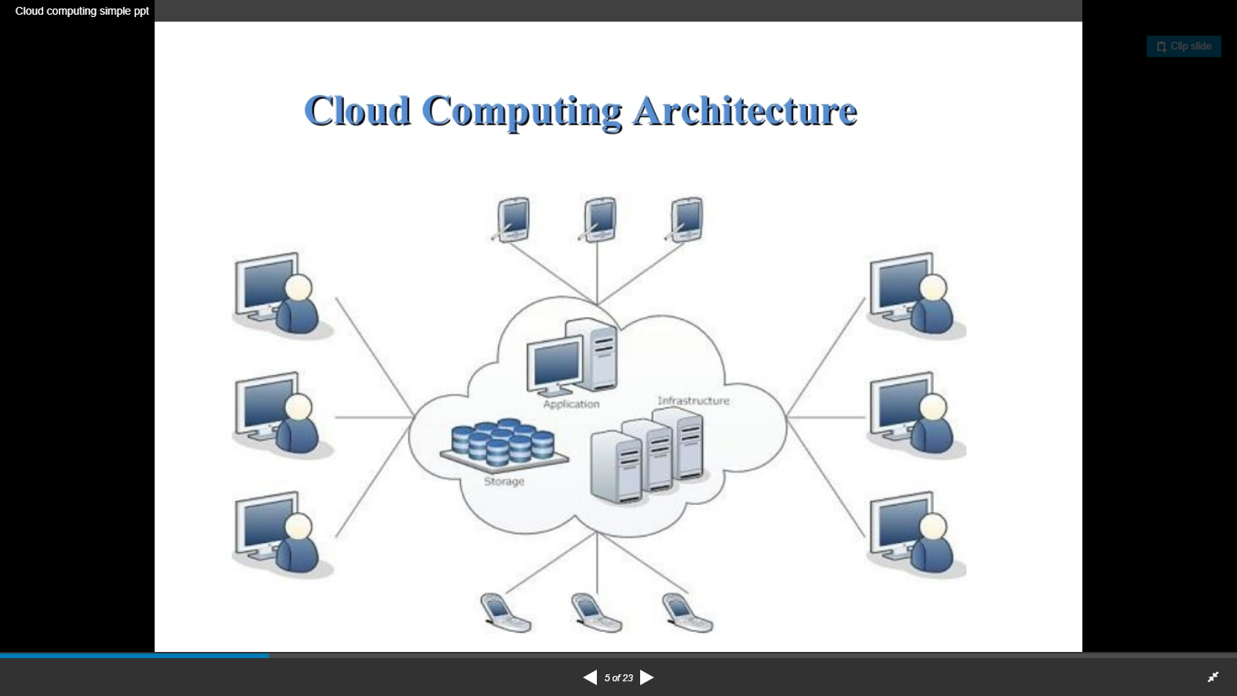

Slide 5
Cloud Computing
Cloud computing is on-demand deliverability of hosted services over the internet. It allows users to access information over the remote location rather than being restricted to a specific place.
The front end is the user side, which allows accessing data present in the cloud over the browser or the computing software.
The back end is the system cloud section which is responsible for securing and storing data. Both these components are integrated to provide the user with a seamless networking platform and manage traffic on the ground.

Slide 6
Difference between Fog computing and Cloud Computing
The main difference between fog computing and cloud computing is that cloud is a centralized system,
while the fog is a distributed decentralized infrastructure. ... In this way, fog is an intelligent gateway that offloads clouds enabling more efficient data storage, processing and analysis.

Slide 7
History of Cloud Computing
Before emerging the cloud computing, there was Client/Server computing which is basically a centralized storage in which all the software applications, all the data and all the controls are resided on the server side.
If a single user wants to access specific data or run a program, he/she need to connect to the server and then gain appropriate access, and then he/she can do his/her business.
Then after, distributed computing came into picture, where all the
computers are networked together and share their resources when needed.
On the basis of above computing, there was emerged of cloud computing
concepts that later implemented.

Slide 8
History of Cloud Computing
At around in 1961, John MacCharty suggested in a speech at MIT that computing can be sold like a utility, just like a water or electricity
In 1999, Salesforce.com started delivering of applications to users using a simple website. The applications were delivered to enterprises over the Internet, and this way the dream of computing sold as utility were true.

Slide 9
History of Cloud Computing
In 2002, Amazon started Amazon Web Services, providing services like storage, computation and even human intelligence. However, only starting with the launch of the Elastic Compute Cloud in 2006 a truly commercial service open to everybody existed.
Amazon Elastic Compute Cloud is a web service that provides resizable compute capacity in the cloud. It is designed to make web-scale computing easier for developers.

Slide 10
History of Cloud Computing
In 2009, Google Apps also started to provide cloud
computing enterprise applications.
Same year Microsoft launched Windows Azure, and
companies like Oracle and HP have all joined the game. This proves that today, cloud computing has become mainstream.

Slide 11
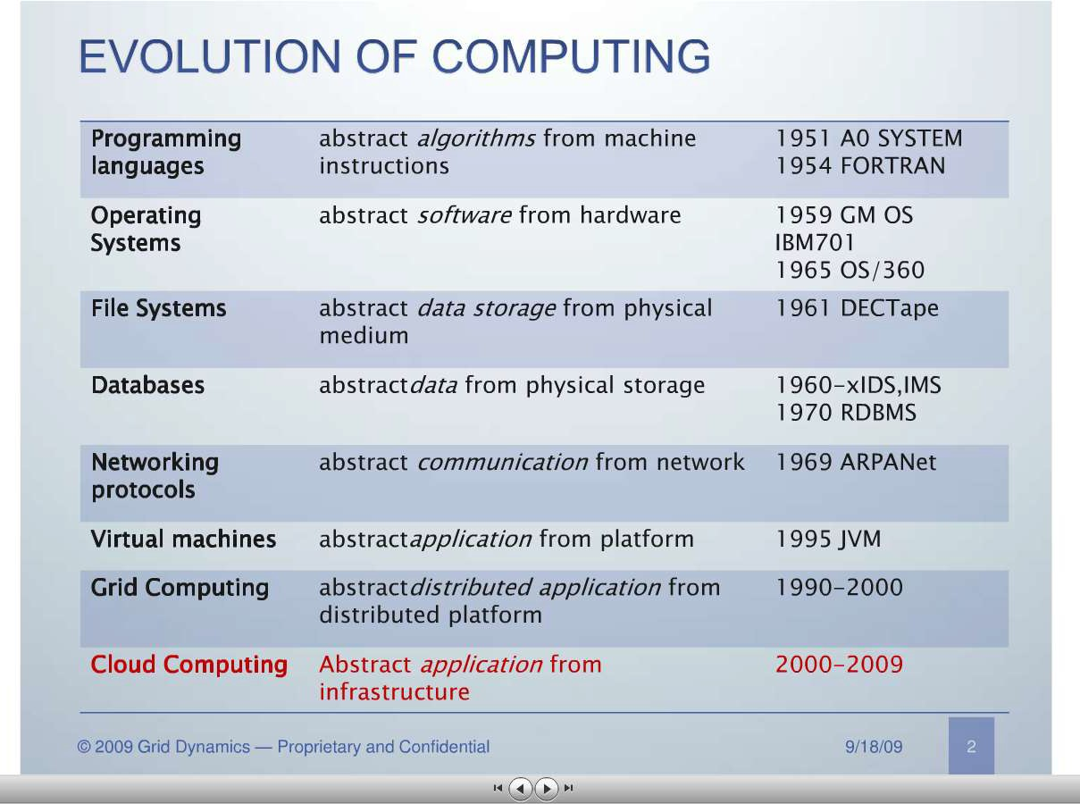

Slide 12
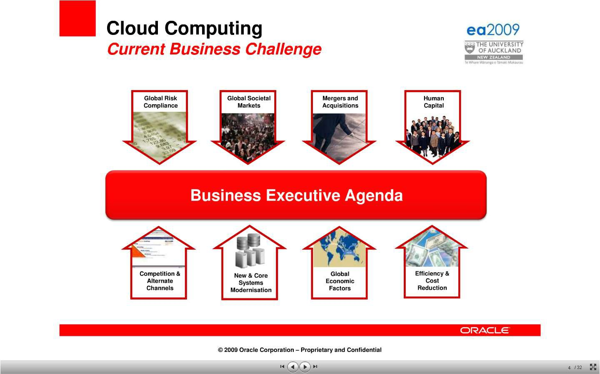
http://www.slideshare.net/marccaltabiano/ea2009-enterprise-architecture-keynote

Slide 13
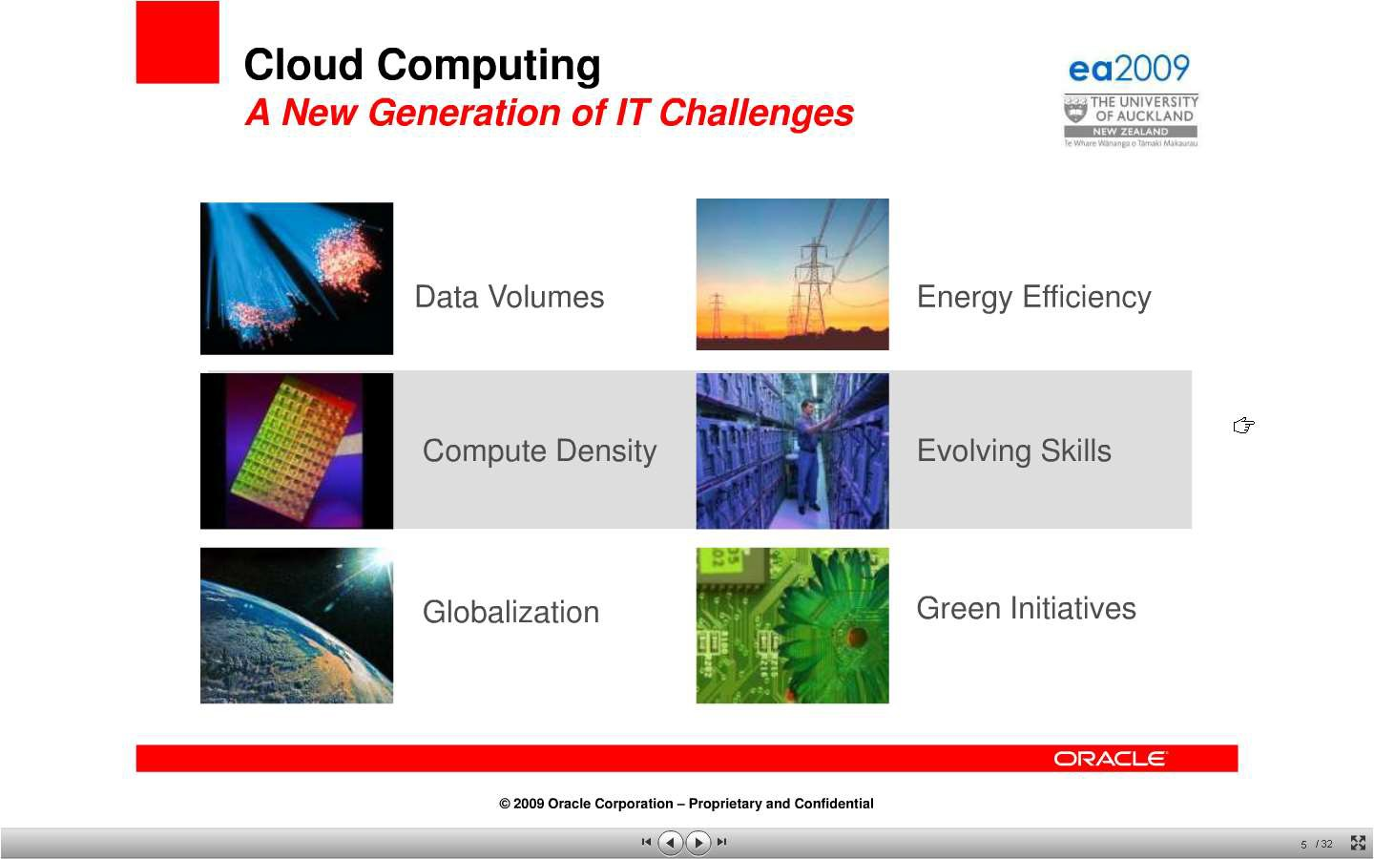

Slide 14
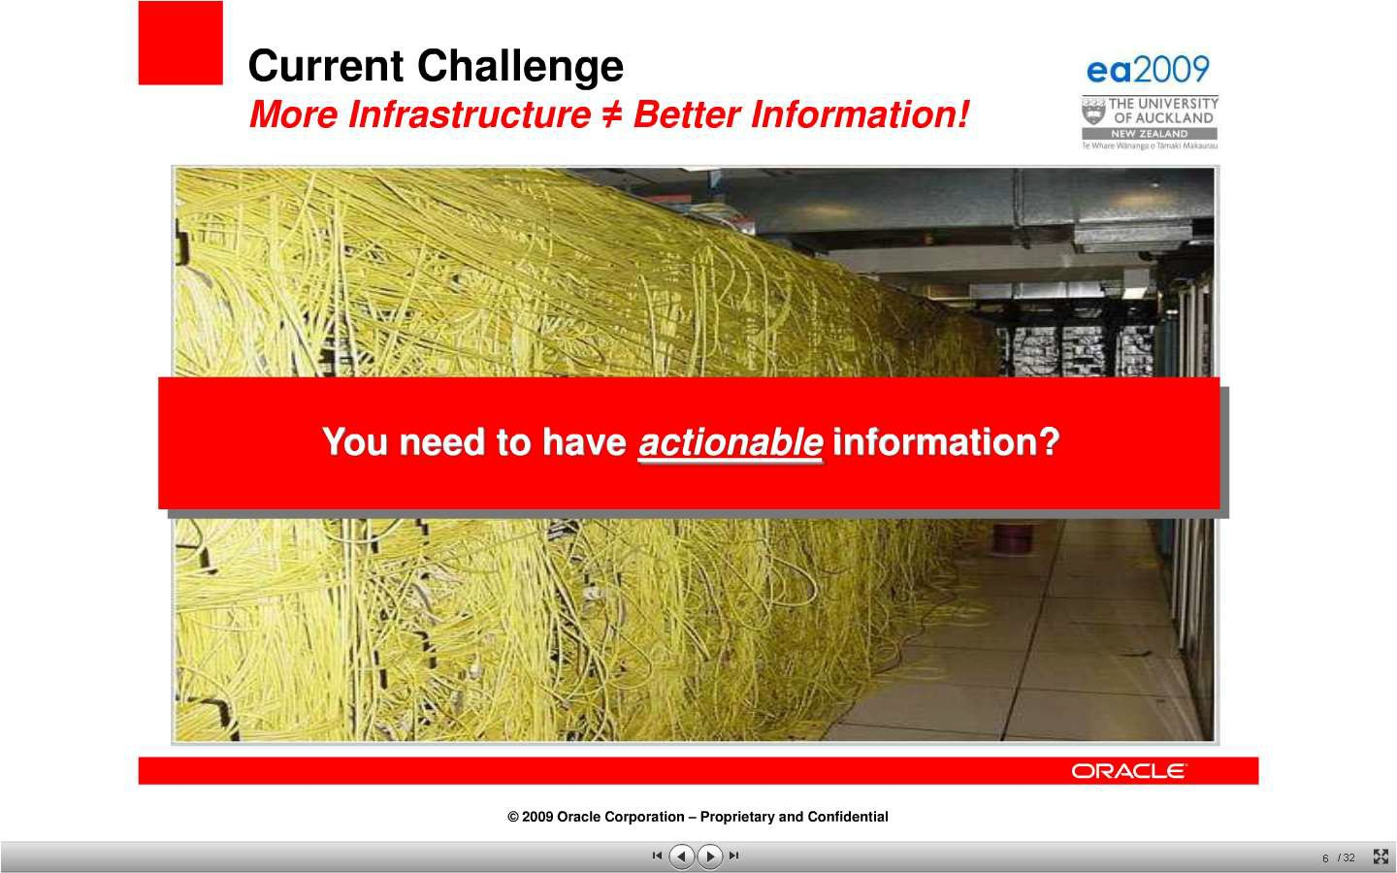

Slide 15
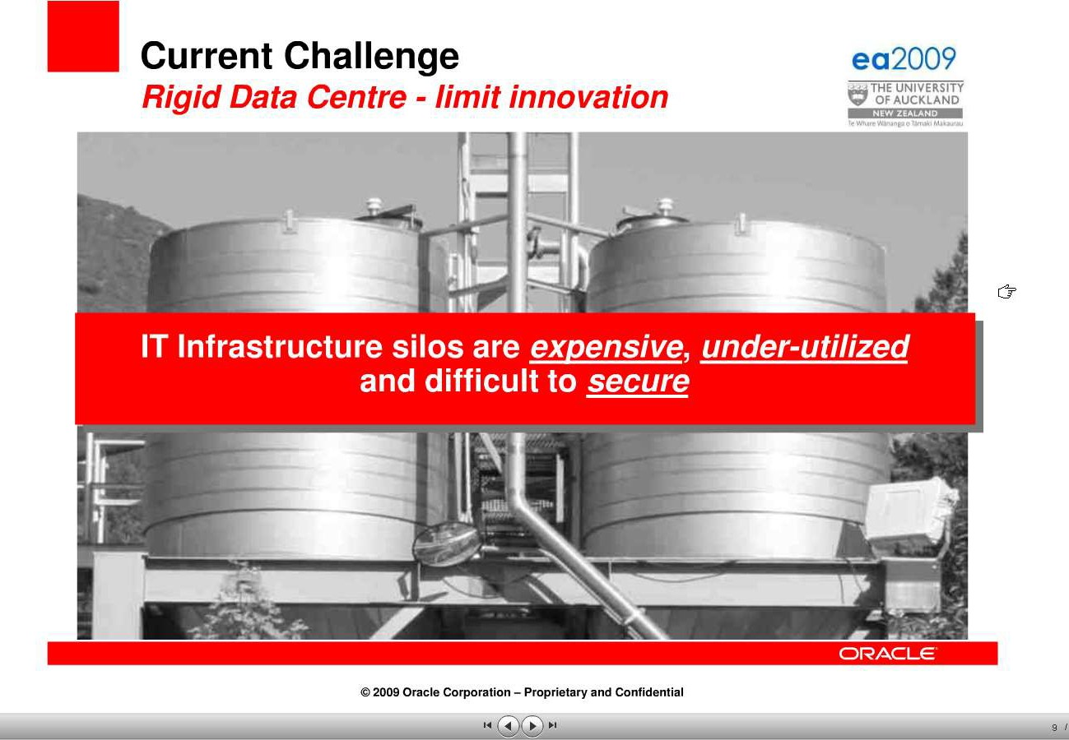

Slide 16
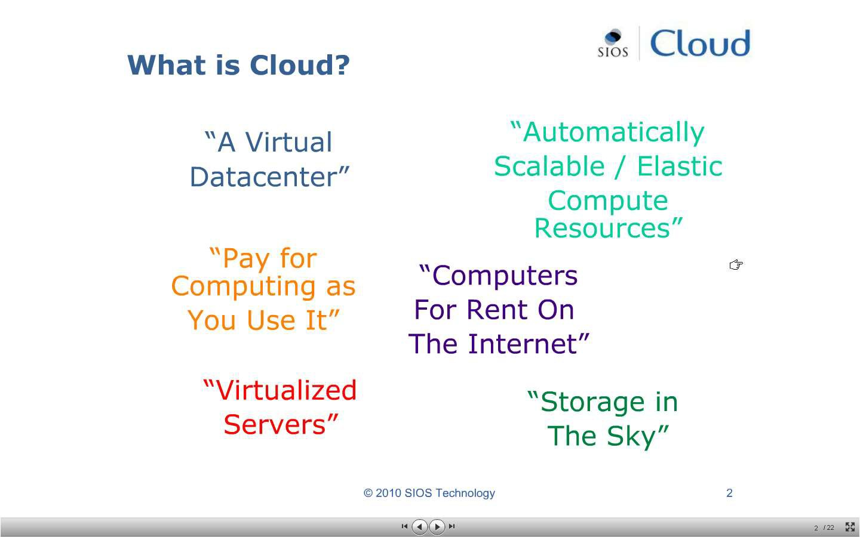

Slide 17

What is ?
Cloud computing is a technology that uses the internet and central remote servers to maintain data and applications.
A simple example of cloud computing is Yahoo email or Gmail etc,.

Slide 18
CLOUD COMPUTING:DEFINITION
Cloud computing means on demand delivery of IT resources via the internet with pay-as-you- go pricing. It provides a solution of IT infrastructure in low cost.

Slide 19
A style of computing where massively scalable (and elastic) IT-related capabilities are
provided “as a service” to external customers using Internet technologies.

Slide 20
The analogy is , 'If you only need milk , would you buy a cow ?' All the users or consumers need is to get the benefits of using the software or hardware of the computer like sending emails etc. Just to get this benefit (milk) why should a consumer buy a (cow) software /hardware ?

Slide 21
Cloud computing is broken down into three segments:
"applications,“
"platforms," and
"infrastructure."

Slide 22
Cloud Computing Segments
Applications: It's all On Demand
On Demand software services
Who is Offering On Demand Software?
International Business Machines (IBM)
Salesforce.com (CRM)
EfroTech.com (HRIS)
Google (GOOG)
NetSuite (N)
Cordys
Taleo (TLEO)
Concur Technologies (CNQR)

Slide 23
A cloud platform refers to the operating system and hardware of a server in an Internet-based data center. It allows software and hardware products to co-exist remotely and at scale. ... Enterprises rent access to compute services, such as servers, databases, storage, analytics, networking, software, and intelligence.

Slide 24
Cloud Computing Segments
Platforms
allow users to access applications from centralized servers using the internet.
Active platforms -
International Business Machines (IBM) - IBM Cloud - Lotus Live
Google (GOOG) - Apps Engine
Amazon.com (AMZN) - EC2
Microsoft (MSFT) - Windows Azure
Logicworks (www.logicworks.net) - infiniCloud
SAVVIS (SVVS) - Symphony VPDC
Terremark Worldwide (TMRK) - The Enterprise Cloud
Salesforce.com (CRM) - Force.com
NetSuite (N) - Suiteflex
Rackspace Cloud - cloudservers, cloudsites, cloudfiles
[http://www.metrisoft.com Metrisoft

Slide 25
Cloud Computing Segments
Infrastructure
allow users to build applications
Major Infrastructure Vendors
Google (GOOG) - Managed hosting, development environment
International Business Machines (IBM) - Managed hosting
SAVVIS (SVVS) - Managed hosting & cloud computing
Terremark Worldwide (TMRK) - Managed hosting
Amazon.com (AMZN) - Cloud storage
Rackspace Hosting (RAX) - Managed hosting & cloud
computing

Slide 26
X as a Service
"X as a Service" or "Anything as a Service " or "Everything as a Service. “
XaaS encompasses
SaaS (Software as a Service),
PaaS (Platform as a Service),
IaaS (Infrastructure as a Service),
HaaS (Hardware as a Service),
MaaS (Management as a Service),
CaaS (Communications as a Service) or
DaaS (Data or Database or Desktop as a Service).
Unified public + private (on-premises) cloud + Military grade security + full Data Control
+ Breakthrough workforce efficiency (http://www.xaas.com/)

Slide 27
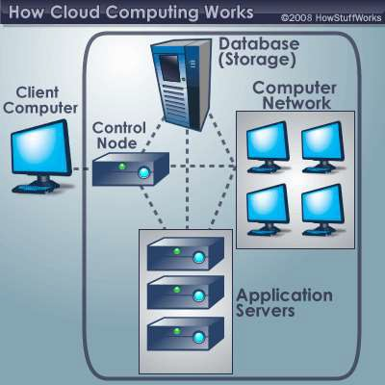
A typical cloud computing system
the front end
Dr.Kª.^{n}As^{d}hok kumar, Asso.Profess^{t}o^{h}r,^{e}C^{b}SEª, S^{c}I^{k}ST ^{end.}
http://computer.howstuffworks.com/cloud-computing1.htm

Slide 28
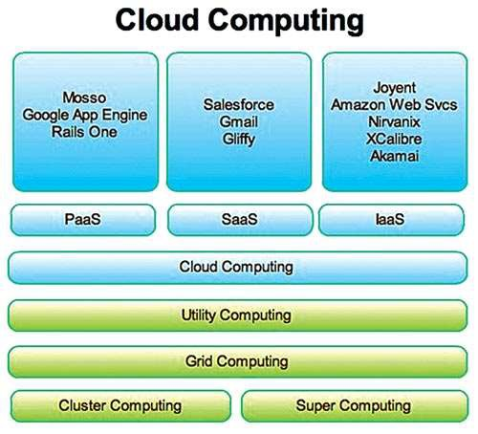

Slide 29
NEED OF CLOUD COMPUTING
Small as well as some large IT companies follows the traditional methods to provide the IT infrastructure
In their server room, there should be a database server, mail server, networking, firewalls, routers, modem, switches, QPS (Query Per Second means how much queries or load will be handled by the server) , configurable system, high net speed and the maintenance engineers.
To establish such IT infrastructure, we need to spend lots of money. To overcome all these problems and to reduce the IT infrastructure cost, Cloud Computing comes into existence.

Slide 30
Characteristics of Cloud Computing
Agility
- The cloud works in the distributed computing environment. It shares resources among users and works very fast.Ability to move quickly and easily.
High availability and reliability
- Availability of servers is high and more reliable, because chances of infrastructure failure are minimal.

Slide 31
Characteristics of Cloud Computing
High Scalability
- Means "on-demand" provisioning of resources on a large scale, without having engineers for peak loads.
Multi-Sharing
- With the help of cloud computing, multiple users and applications can work more efficiently with cost reductions by sharing common infrastructure.

Slide 32
Characteristics of Cloud Computing
Device and Location Independence
- Cloud computing enables the users to access systems using a web browser regardless of their location or what device they use e.g. PC, mobile phone etc. As infrastructure is off-site (typically provided by a third-party) and accessed via the Internet, users can connect from anywhere.

Slide 33
Characteristics of Cloud Computing
Maintenance
- Maintenance of cloud computing applications is easier, since they do not need to be installed on each user's computer and can be accessed from different places. So, it reduces the cost also.
Low Cost
- By using cloud computing, the cost will be reduced because to take the services of cloud computing, IT company need not to set its own infrastructure and pay-as-per usage of resources.

Slide 34
Characteristics of Cloud Computing
Services in pay-per-use mode
-Application Programming Interfaces (APIs) are provided to the users so that they can access services on the cloud by using these APIs and pay the charges as per the usage of services.

Slide 35
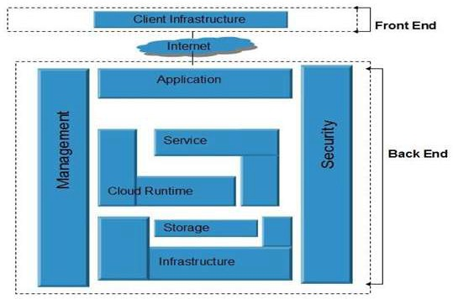
Architectural framework

Slide 36
Components of Cloud Computing Architecture
A front-end platform that can include fat clients, thin clients, and mobile devices
Back-end platforms, such as servers and storage
Cloud-based delivery
A network (internet, intranet)

Slide 37
Front End and Back End Cloud Computing
At its most basic, cloud architecture can be classified into two sections: front-end and back-end, connected to each other via a virtual network or the internet.
There are other parts of cloud architecture including middleware, cloud
resources, etc., but for now we’ll just review the basics.
Front End Cloud Computing
Front-end is the side that is visible to the client, customer, or user. Front-end pieces include the user interface, and the client’s computer system or network that is used for accessing the cloud system. You have probably noticed that different cloud computing systems use different user interfaces.
For example, not only can you choose from a variety of web browsers (including Chrome, Safari, Firefox, etc.), but the Google Docs user interface is different than that of Salesforce.

Slide 38
Front End and Back End Cloud Computing
Back End Cloud Computing
On the other hand, the back-end pieces are on the side used by the service provider. These include various servers, computers, data storage systems, virtual machines, and programs that together constitute the cloud of computing services. The back-end side also is responsible for providing security mechanisms, traffic control and protocols that connect networked computers for communication.
To briefly summarize: the front-end is the part you see, and the back-end is the computing that happens behind the scenes.

Slide 39
Cloud Services Network
Cloud services can be delivered publicly or privately using the internet and can also remain within a company’s network when delivered over an intranet. Sometimes, organizations make use of a combination of both.
No matter where the actual “cloud” is—a company’s own data center or a service provider’s data center, cloud computing uses networking to enable convenient, on-demand access to a shared pool of computing resources like networks, storage, servers, services, and applications. By using virtualization, these assets can be provisioned and released quickly and easily as necessary.

Slide 40
You've Been Virtually Served
Most of the time, servers don't run at full capacity. That means there's unused processing power going to waste. It's possible to fool a physical server into thinking it's actually multiple servers, each running with its own independent operating system. The technique is called server virtualization. By maximizing the output of individual servers, server virtualization reduces the need for more physical machines.
7/2/2021
Ashok kumar, CSE

Slide 41
Difference between Grid Computing and Cloud Computing
While grid computing involves virtualizing computing resources to store massive amounts of data, whereas cloud computing is where an application doesn't access resources directly, rather it accesses them through a service over the internet.

Slide 42
Cloud Computing Applications
Clients would be able to access their applications and data from anywhere at any time.
It could bring hardware costs down.
Corporations that rely on computers have to make sure they have the right software in place to achieve goals.
Servers and digital storage devices take up space.
Corporations might save money on IT support.
If the cloud computing system's back end is a grid computing system, then the client could take advantage of the entire network's processing power.
7/2/2021
Ashok kumar, CSE

Slide 43
Cloud Computing Concerns
Perhaps the biggest concerns about cloud computing are security and privacy.
Authentication , authorization
Private Eyes Are Watching You
There are a few standard hacker tricks that could cause cloud computing companies major headaches. One of those is called key logging.
A key logging program records keystrokes. If a hacker manages successfully to load a key logging program on a victim's computer, he or she can study the keystrokes to discover user names and passwords.
7/2/2021
Ashok kumar, CSE

Slide 44
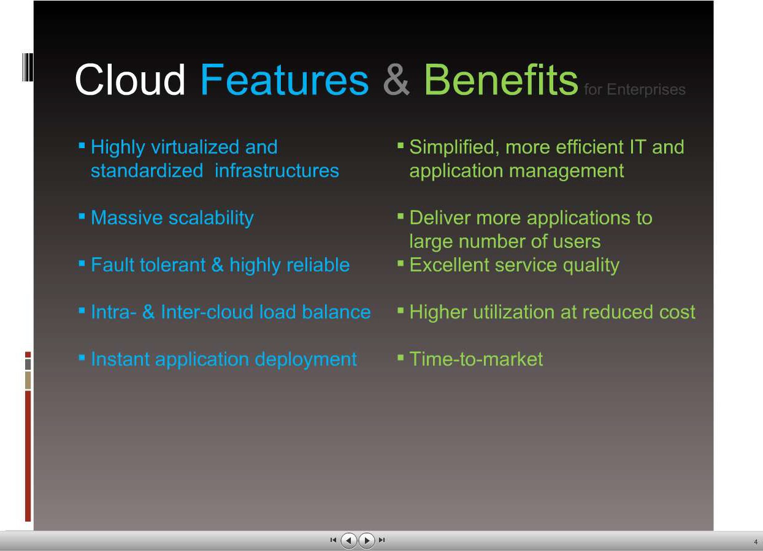
7/2/2021
Ashok kumar, CSE

Slide 45
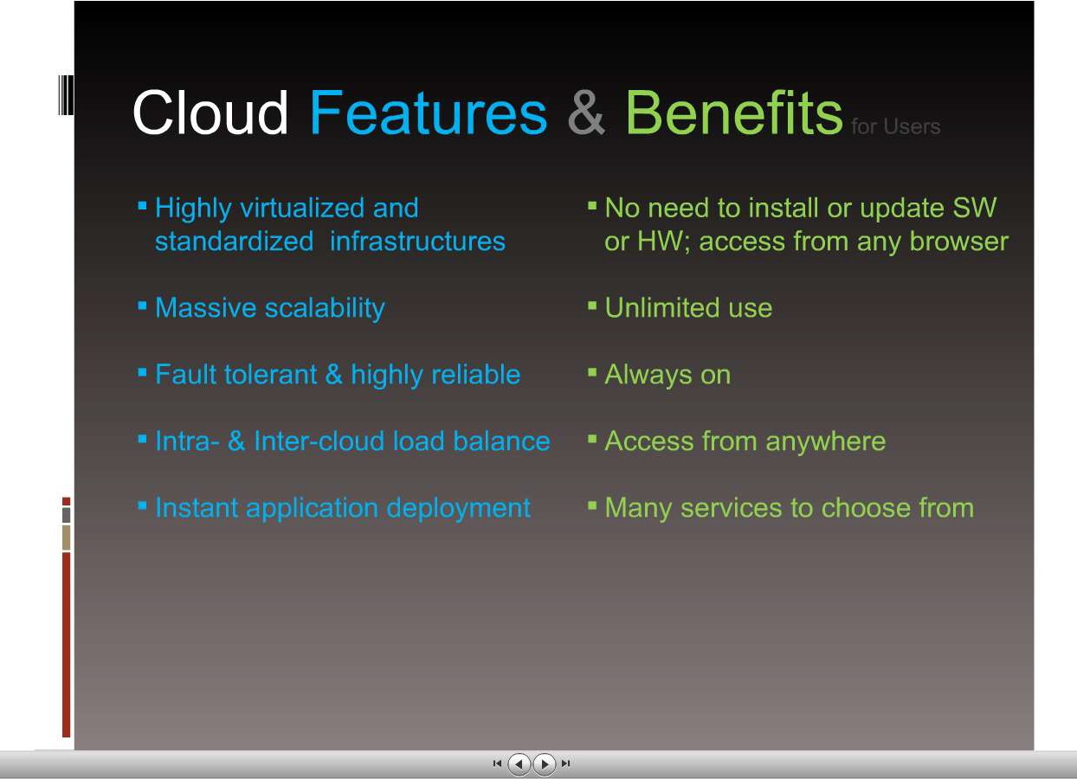
7/2/2021
Ashok kumar, CSE

Slide 46
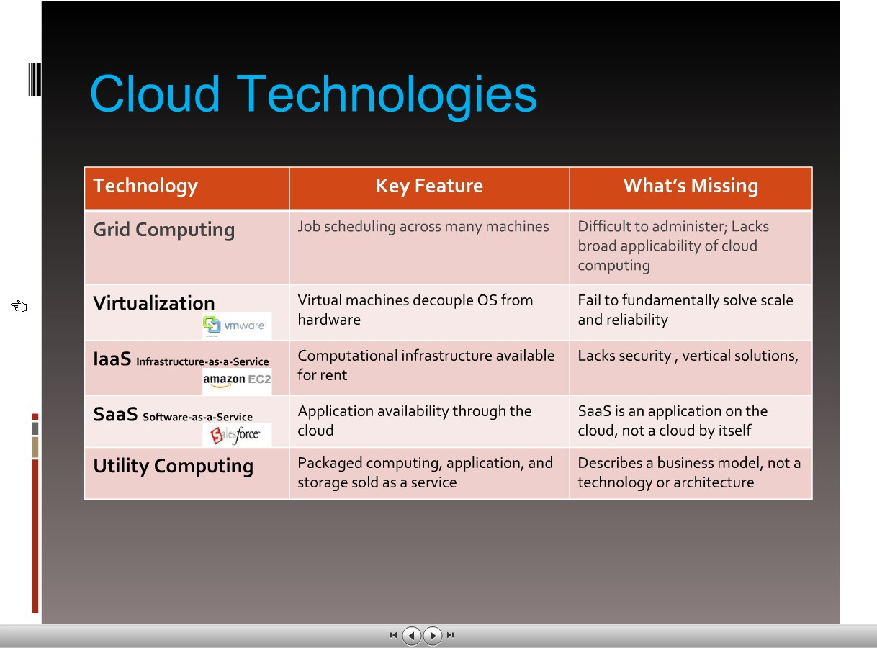
http://www.slideshare.net/andyandrews/cloud-computing-ppt
7/2/2021
Ashok kumar, CSE

Slide 47
Types of cloud:
Public Cloud
Private Cloud
Hybrid Cloud

Slide 48
Public Cloud
Public cloud allows the accessibility of systems and services easily to general public. Eg: Amazon, IBM, Microsoft, Google, Rackspace etc.
The public cloud is defined as computing services offered by third-party providers over the public Internet, making them available to anyone who wants to use or purchase them. They may be free or sold on-demand, allowing customers to pay only per usage for the CPU cycles, storage, or bandwidth they consume.

Slide 49
Advantages of Public Cloud Model
Low Cost
Reliable
Flexible
Location Independent
High Scalability

Slide 50
Disadvantages of Public Cloud Model
Low security
In public cloud model, data is present off-site and resources are shared publicly. Hence it does not ensure the high level security.
Less customizable
It is less customizable than private cloud.

Slide 51
Private Cloud
The Private cloud allows the accessibility of systems and services within the organization. Private cloud is operated only within a particular organization. But it will be managed internally or by third party.

Slide 52
Advantages of Private Cloud Model
High security and privacy
- Private cloud resources are shared from distinct pool of resources and hence highly secured.
More Control
-Private clouds resources and
have more control on its
hardware
accessed only within the
than public cloud
because it is
boundary of an organization.

Slide 53
Disadvantages of Private Cloud Model
Restriction
-Private cloud is only accessible locally and it is very difficult to deploy globally.
More Cost
- Private cloud is having more cost than public clouds.
Inflexible price
- In order to fulfill demands, purchasing new hardware is very costly.
Less Scalability
- Private clouds are scaled only within capacity of internal hosted resources.

Slide 54
Hybrid Cloud
The Hybrid cloud is the mixture of public and private cloud. Non-critical activities are performed by public cloud while critical activities are performed by private cloud.

Slide 55
Advantages of Hybrid Cloud Model
Scalable
-It provides both the features of public and private cloud scalability.
Flexible and secure
- It provides secure resources because of private cloud and scalable resources because of public cloud.

Slide 56
Advantages of Hybrid Cloud Model
Cost effective
- It is having less cost as compared to private cloud.

Slide 57
Disadvantages of Hybrid Cloud Model
Networking issues
Networking becomes complex because of private and public cloud.
Security Compliance
It is necessary to ensure that cloud services are compliant with the security policies of an organization.

Slide 58
PUBLIC CLOUD : The Public Cloud allows systems and services to be easily accessible to the general public. Public cloud may be less secure because of its openness, e.g., e-mail.
PRIVATE CLOUD : The Private Cloud allows systems and services to be accessible within an organization. It offers increased security because of its private nature.
COMMUNITY CLOUD : The Community Cloud allows systems and services to be accessible by group of organizations.
HYBRID CLOUD : The Hybrid Cloud is mixture of public and private cloud. However, the critical activities are performed using private cloud while the non-critical activities are performed using public cloud.

Slide 59
Basic Concepts
There are certain services and models working behind the scene making the cloud computing feasible and accessible to end users. Following are the working models for cloud computing:
Deployment Models
Service Models

Slide 60
Deployment Models
Deployment models define the type of access to the cloud, i.e., how the cloud is located? Cloud can have any of the four types of access: Public, Private, Hybrid and Community.

Slide 61
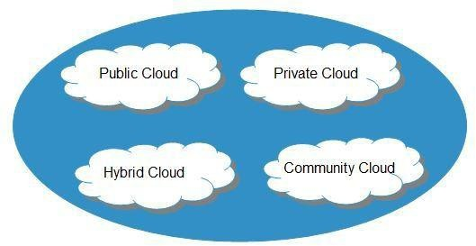

Slide 62
PUBLIC CLOUD : The Public Cloud allows systems and services to be easily accessible to the general public. Public cloud may be less secure because of its openness, e.g., e-mail.
PRIVATE CLOUD : The Private Cloud allows systems and services to be accessible within an organization. It offers increased security because of its private nature.
COMMUNITY CLOUD : The Community Cloud allows systems and services to be accessible by group of organizations.
HYBRID CLOUD : The Hybrid Cloud is mixture of public and private cloud. However, the critical activities are performed using private cloud while the non-critical activities are performed using public cloud.

Slide 63
Service Models
Service Models are the reference models on which the Cloud Computing is based. These can be categorized into three basic service models as listed below:

Slide 64
Infrastructure as a Service (IaaS)
Platform as a Service (PaaS)
Software as a Service (SaaS)

Slide 65
Infrastructure as a Service (IaaS)
IaaS is the delivery of technology infrastructure as an on demand scalable service.
IaaS provides access to fundamental resources such as physical machines, virtual machines, virtual storage, etc.
Usually billed based on usage
Usually multi tenant virtualized environment
Can be coupled with Managed Services for OS and application support

Slide 66
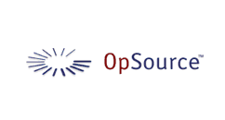



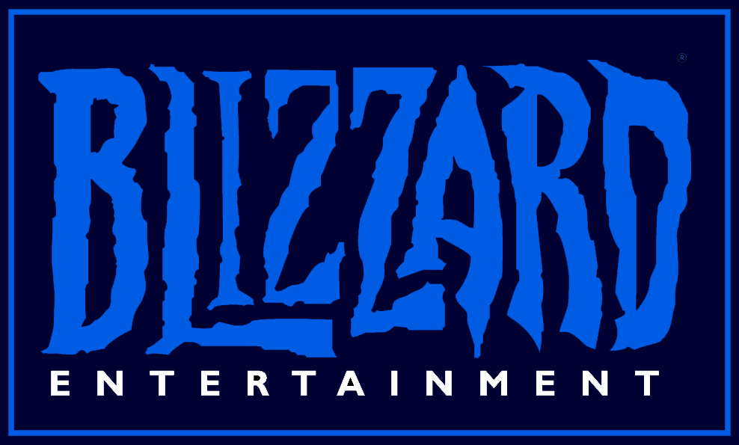

IaaS Examples

Slide 67
Platform as a Service (PaaS)
PaaS provides the runtime environment for applications, development & deployment tools, etc.
PaaS provides all of the facilities required to support the complete life cycle of building and delivering web applications and services entirely from the Internet.
Typically applications must be developed with a particular platform in mind
Multi tenant environments
Highly scalable multi tier architecture

Slide 68


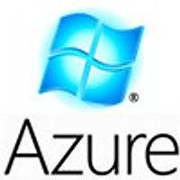



PaaS Examples

Slide 69
Software as a Service (SaaS)
SaaS model allows to use software applications as a service to end users.
SaaS is a software delivery methodology that provides licensed multi-tenant access to software and its functions remotely as a Web-based service.
•
•
•
Usually billed based on usage Usually multi tenant environment Highly scalable architecture

Slide 70

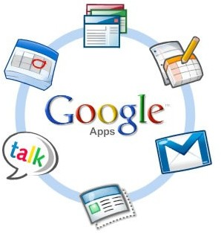

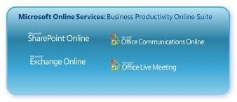

SaaS Examples

Slide 71
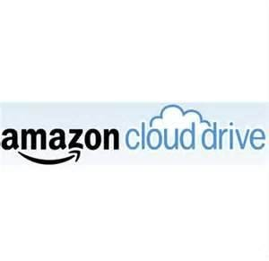
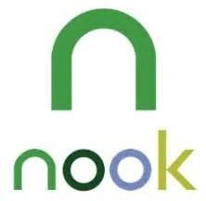

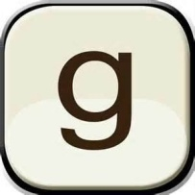
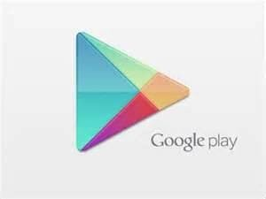

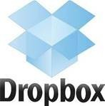





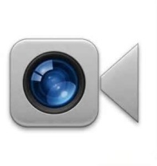



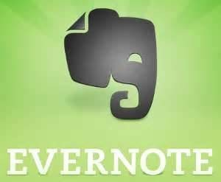
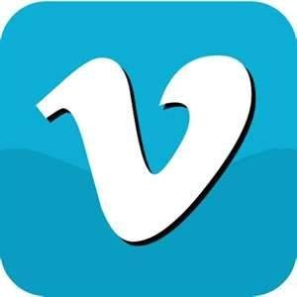
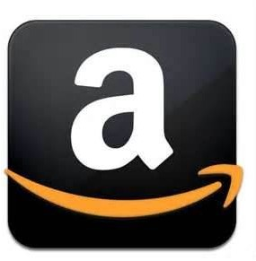
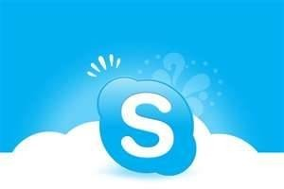

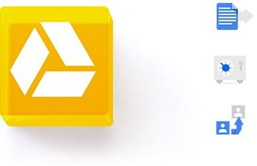
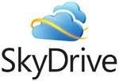

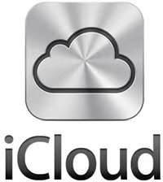
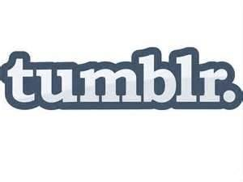



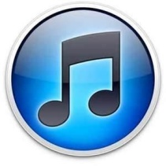

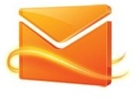


Do you Use the Cloud?

Slide 72
PROS AND CONS OF CLOUD COMPUTING:
Advantages of Cloud Computing
There are various advantages of cloud computing technology. The important advantages of cloud computing are given below.
Lower cost computer for users
Lower IT infrastructure cost
Fewer maintenance cost
Lower Software Cost
Instant software updates
Increased computing Power
Unlimited storage capacity

Slide 73
PROS AND CONS OF CLOUD COMPUTING
Disadvantages of Cloud Computing
There are various disadvantages of cloud computing technology. The important disadvantages of cloud computing are given below.
Require a constant Internet Connection
Require High Speed Internet connection
Stored Data Might Not Be Secure

Slide 74
Key challenges in cloud computing
There are also many challenges involved in cloud computing, and if you’re not prepared to deal with them, you won’t realize the benefits. Here are six common challenges you must consider before implementing cloud computing technology.

Slide 75
Key challenges in cloud computing
Cost
Service Provider Reliability
Downtime
Password Security
Data privacy
Vendor lock-in

Slide 76
Key challenges in cloud computing
Cost
Cloud computing itself is affordable, but tuning the platform according to the company’s needs can be expensive. Furthermore, the expense of transferring the data to public clouds can prove to be a problem for short-lived and small-scale projects.

Slide 77
Key challenges in cloud computing
Service Provider Reliability
The capacity and capability of a technical service provider are as important as price. The service provider must be available when you need them. The main concern should be the service provider’s sustainability and reputation.

Slide 78
Downtime is a computer industry term for the time during which a computer or IT system is unavailable, offline or not operational. Downtime has many causes, including shutdowns for maintenance (known as scheduled downtime), human errors, software or hardware malfunctions, and environmental disasters such as power outages, fires, flooding or major temperature changes. In industrial environments, downtime may refer to failures in production equipment.

Slide 79
Key challenges in cloud computing
Downtime
Downtime is a significant shortcoming of cloud technology. No seller can promise a platform that is free of possible downtime. Cloud technology makes small companies reliant on their connectivity, so companies with an untrustworthy internet connection probably want to think twice before adopting cloud computing.

Slide 80
Key challenges in cloud computing
Password Security
Industrious password supervision plays a vital role in cloud security. However, the more people you have accessing your cloud account, the less secure it is. Anybody aware of your passwords will be able to access the information you store there.
Businesses should employ multi-factor authentication and make sure that passwords are protected and altered regularly, particularly when staff members leave. Access rights related to passwords and usernames should only be allocated to those who require them.

Slide 81
Key challenges in cloud computing
Data privacy
Sensitive and personal information that is kept in the cloud should be defined as being for internal use only, not to be shared with third parties. Businesses must have a plan to securely and efficiently manage the data they gather.

Slide 82
The vendor lock-in problem in cloud computing is the situation where customers are dependent (i.e. locked-in) on a single cloud provider technology implementation and cannot easily move in the future to a different vendor without substantial costs, legal constraints, or technical incompatibilities.

Slide 83
Vendor lock-in can become an issue in cloud computing because it is very difficult to move databases once they're set up, especially in a cloud migration, which involves moving data to a totally different type of environment and may involve reformatting the data.

Slide 84
Key challenges in cloud computing
Vendor lock-in
Entering a cloud computing agreement is easier than leaving it. “Vendor lock-in” happens when altering providers is either excessively expensive or just not possible. It could be that the service is nonstandard or that there is no viable vendor substitute.
It comes down to buyer carefulness. Guarantee the services you involve are typical and transportable to other providers, and above all, understand the requirements.

Slide 85
Cloud players
Top 5 cloud players
#1 Microsoft
#2 Amazon
#3 IBM
#4 Salesforce.com
#5 SAP

Slide 86
Deployment Models
A Cloud Computing deployment model is a model that describes the environment where cloud applications and services can be installed.
Public Cloud
Private Cloud
Hybrid Cloud
Community Cloud

Slide 87
Public Cloud
Public Cloud is a type of cloud hosting that allows the accessibility of systems & its services to its clients/users easily. Some of the examples of those companies which provide public cloud facilities are IBM, Google, Amazon, Microsoft, etc
Public cloud is better suited for business purposes for managing the load. This type of cloud is economical due to the decrease in capital overheads.

Slide 88
The advantages of the Public cloud are:
Flexible
Reliable
High Scalable
Low cost
Place independence

Slide 89
Some Disadvantages
Less Secured
Poor Customizable

Slide 90
Private Cloud
Private Cloud also termed as 'Internal Cloud'; which allows the accessibility of systems and services within a specific boundary or organization. The cloud platform is implemented in a cloud-based secure environment that is guarded by advanced firewalls under the surveillance of the IT department that belongs to a particular organization. Private clouds permit only authorized users, providing the organizations greater control over data and its security. Business organizations that have dynamic, critical, secured, management demand based requirement should adopt Private Cloud.

Slide 91
The advantages of using private cloud are
Highly private and secured - Private cloud resource sharing is highly secured.
Control Oriented- Private clouds provide more control over its resources than public cloud as it can be accessed within the organization's boundary.

Slide 92
Disadvantages
Poor scalability - Private type of clouds is scaled within internal limited hosted resources.
Costly - As it provides secured and more features, so it's more expensive than a public cloud.
Pricing - is inflexible; i.e., purchasing new hardware for up-gradation is more costly.
Restriction - It can be accessed locally within an organization and is difficult to expose globally.

Slide 93
Hybrid Cloud
Hybrid Cloud is another cloud computing type, which is integrated, i.e., it can be a combination of two or more cloud servers, i.e., private, public or community combined as one architecture, but remain individual entities
Non-critical tasks such as development and test workloads can be done using public cloud whereas critical tasks that are sensitive such as organization data handling are done using a private cloud. Benefits of both deployment models, as well as community deployment model, are possible in a hybrid cloud hosting

Slide 94
Advantages of Hybrid Cloud Computing are:
Flexible
Secure
Cost Effective
Rich Scalable

Slide 95
Disadvantages of Hybrid Cloud are:
Complex networking problem
Organization's security Compliance

Slide 96
Community Cloud
It is another type of cloud computing in which the setup of the cloud is shared manually among different organizations that belong to the same community or area. Example of such a community is where organizations/firms are there along with the financial institutions/banks. A multi-tenant setup developed using cloud among different organizations that belong to a particular community or group having similar computing concern.

Slide 97
Virtualization
The term 'Virtualization' can be used in many respect of computer. It is the process of creating a virtual environment of something which may include hardware platforms, storage devices, OS, network resources, etc.
Virtualization is the ability which allows sharing the physical instance of a single application or resource among multiple organizations or users. This technique is done by assigning a name logically to all those physical resources & provides a pointer to those physical resources based on demand.
Over an existing operating system & hardware, we generally create a virtual machine which and above it we run other operating systems or applications. This is called Hardware Virtualization. The virtual machine provides a separate environment that is logically distinct from its underlying hardware. Here, the system or the machine is the host & virtual machine is the guest machine. This virtual environment is managed by a firmware which is termed as a hypervisor.

Slide 98
Virtualization in Cloud Computing
Virtualization is the "creation of a virtual (rather than actual) version of something, such as a server, a desktop, a storage device, an operating system or network resources"..
In other words, Virtualization is a technique, which allows to share a single physical instance of a resource or an application among multiple customers and organizations.

Slide 99
What Is Virtualization?
Virtualization is simply the logical separation of the request for some service from the physical resources that actually provide that service.
In practical terms, virtualization provides the ability to run applications, operating systems, or system services in a logically distinct system environment that is independent of a specific physical computer system.
. Virtualization’s focus on logical operating environments rather than physical ones makes applications, services, and instances of an operating system portable across different physical computer systems.

Slide 100
Example of virtualization
People are already familiar with is virtual memory, which enables a computer system to appear to have more memory than is physically installed on that system.
Virtual memory is a memory-management technique that enables an operating system to see and use noncontiguous segments of memory as a single, contiguous memory space. Virtual memory is traditionally implemented in an operating system by paging,

Slide 101
virtualization
Modern operating systems such as UNIX-like operating systems (including Linux, the *BSD operating systems, and Mac OS X) and Microsoft Windows all use some form of virtual memory to enable the operating system and applications to access more data than would fit into physical memory.
there are many different types of virtualization, all rooted around the core idea of providing logical access to physical resources. Today, virtualization is commonly encountered in networking, storage systems, and server processes, at the operating system level and at the machine level.
. Xen, the subject of this book, supports machine-level virtualization using a variety of clever and powerful techniques

Slide 102
Server Consolidation
Definition - Server consolidation refers to thServer Consolidation e use of a physical server to accommodate one or more server applications or user instances. Server consolidation makes it possible to share a server’s compute resources among multiple applications and services simultaneously. It is mainly used to reduce the number of servers required in an organization.

Slide 103
The Basics of Virtualization
A great example of how virtualization works in your daily life is the separation of your hard drive into different parts.
While you may have only one hard drive, your system sees it as two, three or more different and separate segments.
Similarly, this technology has been used for a long time.

Slide 104
Virtual Machine Monitor
A Virtual Machine Monitor (VMM) is a software program
That enables the creation, management and governance of virtual machines (VM) and manages the operation of a virtualized environment on top of a physical host machine. VMM is also known as Virtual Machine Manager

Slide 105
Virtual Machine
Virtual Machine is defined as software of a computer which provides the functionality similar to the physical computers
They run operating system and applications on top of it but they differ from the physical computer
The fact that they are computer files, known as an image which runs on top of physical computers using the hypervisor.
Due to this the user has the liberty of running multiple operating systems on top of the main operating system without the need of buying additional physical resource.

Slide 106
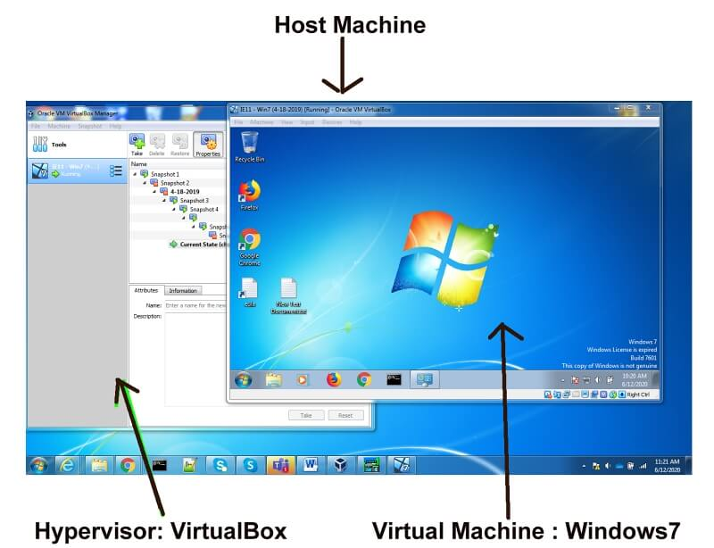
Virtual Machine

Slide 107
Virtual Machine
This means that a computer is created inside a computer. It works in a window, like any program, providing the end-user with the same virtual system
Many virtual machines can run on the same physical computer simultaneously. For servers, several operating systems run side-by-side with the software known to be managed as a hypervisor,
. A hypervisor, also known as a virtual machine monitor or VMM, is software that creates and runs virtual machines (VMs). A hypervisor allows one host computer to support multiple guest VMs by virtually sharing its resources, such as memory and processing.

Slide 108
Virtual Machine
whereas desktop computers normally run other operating systems in their program windows by using one operating system.Experience on the host operating system.
A hypervisor, sometimes called a virtual machine monitor (VMM),

Slide 109
Virtual Machine Advantages

Slide 110
Cost-Effective Software
VMware software is an affordable software that most large scale business can easily afford. Cost-effective does not mean that anyone can afford it but used as other parts that help in business growth.
It improves your business virtualization at affordable rates that have an outstanding track record. So, if you are looking for any type of software for cloud computing then you must give VMware a try.

Slide 111
Entire Test Environment is Low Budget
While testing multiple applications in multiple environments can cost you very high.
But the availability of VMware made things easy and low budget. With the existing function of multiple handling environments.
you can do the entire software test at a reasonable price.

Slide 112
Fast Rollback Feature
VMware software is totally an environment based software for testing and cloud computing.
At the time of adding or creating a new virtual machine, if you face any type of error then you can easily rollback all the things like before.
Using fast rollback features is very beneficial if you suddenly faced a major or minor error and want to end the process.

Slide 113
Adding New Virtual Machine is Easy
One of the best features or advantages of VMware, you can easily add a new virtual machine in plenty of time.
Even the newcomers with basic knowledge can implement a virtual machine which is quite impressive.
Anyone can create an OS (Operating System) or environment with a few simple steps.

Slide 114
Multiple OS Allowed
VMware allows a user to install or create multiple virtual machines so they can relatively works on it.
Not only create but also you can easily access them at the same time which is totally impressive.
For example, you can create a virtual machine with the environment Linux based. After that, you can add some more operating systems like Windows 7, XP, 10, and some others at the same time.
And by launching all these virtual machines at the same time you can easily teleport yourself from one environment to another one.

Slide 115
Easy to Delete Virtual Machine
Just like adding virtual machine features of VMware, you can also delete the entire or specific virtual machine as per need.
It takes a few minutes to perform that task and clean the storage of your device.
After deleting the virtual memory, you have the storage space, in which you can create another virtual machine. Fulfilling such user requirements is one of the advantages of VMware.

Slide 116
Wide Number of Users
Many users make use of VMware for different purposes.
Some users use it for testing software or program in different environments. On the other hand, some users use VMware as a virtual machine and perform ethical hacking practices over it.

Slide 117
Virtual Machine Disadvantages

Slide 118
Low Performance
VMware software is designed to work on high-class devices. So, as per this condition, if your business doesn’t have the best system then you will get low performance.
The same rule applies to personal users too who use VMware for multipurpose use. VMware helps to create a different OS environment that runs on your system resources.

Slide 119
Lack of Reliability
The physical devices play an important role.
Because of this problem lack of reliability occurs. You can’t measure how reliable VMware software can be which is quite depressing.
If your device is not super fast then you will face a lot of problems for sure.

Slide 120
Need Handling Skills
Using VMware is not just too easy for anyone who does not have any technical background.
Also, there’s a chance you probably corrupt your storage device, which is the worst case. So, either you read the basics from the official site or online tutorial after that use the VMware.

Slide 121
Not Best For Complete Physical Product Testing
VMware is designed to test the software or program in a different environment.
But this advanced technology is not best for that software that relies on complete physical testing.
For example, if you are testing a program’s functionalities like Storage, Speed, Reliability and more then you won’t get accurate results at all.
Because reliability and speed are totally depending on your physical testing rather than the environment.

Slide 122
Types of Virtualization in Cloud Computing
Here are six methodologies to look at when talking about virtualization techniques in cloud computing:
Network Virtualization
Storage Virtualizing
Server Virtualization - Machine Virtualization
Desktop Virtualizing
Application Virtualization
System-level or Operating Virtualization

Slide 123
Hardware Virtualization:
When the virtual machine software or virtual machine manager (VMM) is directly installed on the hardware system is known as hardware virtualization.
The main job of hypervisor is to control and monitoring the processor, memory and other hardware resources.
After virtualization of hardware system we can install different operating system on it and run different applications on those OS.
Usage:
Hardware virtualization is mainly done for the server platforms, because controlling virtual machines is much easier than controlling a physical server.

Slide 124
Virtualization in Cloud Computing
Virtualization is the "creation of a virtual (rather than actual) version of something, such as a server, a desktop, a storage device, an operating system or network resources"..
In other words, Virtualization is a technique, which allows to share a single physical instance of a resource or an application among multiple customers and organizations.

Slide 125
Desktop virtualization
Desktop virtualization is technology that lets users simulate a workstation load to access a desktop from a connected device remotely or locally.
This separates the desktop environment and its applications from the physical client device used to access it.
Desktop virtualization can be achieved in a variety of ways, but the most important two types of desktop virtualization are based on whether the operating system instance is local or remote.

Slide 126
The benefits of desktop virtualization?
Resource Management: Desktop virtualization helps IT departments get the most out of their hardware investments by consolidating most of their computing in a data center. Desktop virtualization then allows organizations to issue lower-cost computers and devices to end users because most of the intensive computing work takes place in the data center.
By minimizing how much computing is needed at the endpoint devices for end users, IT departments can save money by buying less costly machines.

Slide 127
Network virtualization
External network virtualization combines or subdivides one or more local area networks (LANs) into virtual networks to improve a large network's or data center's efficiency.

Slide 128
Security
Desktop virtualization software provides IT admins centralized security control over which users can access which data and which applications. If a user’s permissions change because they leave the company, desktop virtualization makes it easy for IT to quickly remove that user’s access to their persistent virtual desktop and all its data—instead of having to manually uninstall everything from that user’s devices.
And because all company data lives inside the data center rather than on each machine, a lost or stolen device does not post the same data risk. If someone steals a laptop using desktop virtualization, there is no company data on the actual machine and hence less risk of a breach.

Slide 129
Virtualization
Grid Approach - where the processing workloads are distributed among different physical servers, and their results are then collected as one.
OS - Level Virtualization -Here, multiple instances of an application can run in an isolated form on a single OS
Hypervisor-based Virtualization-With hypervisor's virtualization, there are various sub- approaches to fulfill the goal to run multiple applications & other loads on a single physical host

Slide 130
Virtualization
Hardware Virtualization -It is the abstraction of computing resources from the software that uses cloud resources. It involves embedding virtual machine software into the server's hardware components. That software is called the hypervisor.

Slide 131
Virtualization
Three types of hardware virtualizations
Full Virtualization - Here the hardware architecture is completely simulated. Guest software doesn't need any modification to run any applications
Para-Virtualization - Here, the hardware is not simulated; instead the guest software runs its isolated system

Slide 132
Software virtualization
It is also called application virtualization
Software virtualization is similar to that of virtualization except that it is capable to abstract the software installation procedure and create virtual software installation. Many applications & their distributions became typical tasks for IT firms and departments. The mechanism for installing an application differs.
So virtualized software is introduced in which an application that will be installed into its self-contained unit and provide software virtualization. Some of the examples are Virtual Box, VMware, etc
Benefits are Ease of Client Deployment , Software Migration, Easy to Manage

Slide 133
Server virtualization:
In this process, the server resources are kept hidden from the user. This partitioning of physical server into several virtual environments; result in the dedication of one server to perform a single application or task.
This technique is mainly used in web-servers which reduces the cost of web-hosting services. Instead of having separate system for each web-server, multiple virtual servers can run on the same system/computer.

Slide 134
Primary uses of server virtualization are:
To centralize the server administration
Improve the availability of server
Helps in disaster recovery
Ease in development & testing
Make efficient use of server resources.

Slide 135
Cloud resource management
Critical function of any man-made system.
It affects the three basic criteria for the evaluation of a system like:
Functionality.
Performance.
Cost.

Slide 136
Cloud resource management
Cloud resource management requires complex policies and decisions for multi-objective optimization.
Effective resource management is extremely challenging due to the scale of the cloud infrastructure and to the unpredictable interactions of the system with a large population of users.
The large user population makes it impossible to predict the type and the intensity of the system workload.

Slide 137
Scheduling
Scheduling in a computing system deciding how to allocate resources of a system, such as CPU cycles, memory, secondary storage space, I/O and network bandwidth, between users and tasks.
Policies and mechanisms for resource allocation.
Policy: principles guiding decisions.
Mechanisms: the means to implement policies

Slide 138
Cloud resource management (CRM) policies
1. Admission control: prevent the system from accepting workload in violation of high-level system policies.
•
2. Capacity allocation: allocate resources for
individual activations of a service.
3. Load balancing: distribute the workload evenly among the servers
4. Energy optimization: minimization of energy consumption
5. Quality of service (QoS) guarantees: ability to satisfy timing or other conditions specified by a Service Level Agreement

Slide 139
Dynamic resource allocation
Cloud Computing environment can supply of computing resources on the basis of demand and when needed
Managing the customer demand creates the challenges of on-demand resource allocation.
Effective and dynamic utilization of the resources in cloud can help to balance the load and avoid situations like slow run of systems.
Cloud computing allows business outcomes to scale up and down their resources based on needs.

Slide 140
Virtual Machines are allocated to the user based on their job in order to reduce the number of
physical servers in the cloud environment
If the VM is available then job is allowed to run on the VM.
If the VM is not available then the algorithm finds a low priority job taking into account the job’s lease type.

Slide 141
The strategies for resource management for IaaS, PaaS, and SaaS are different.

Slide 142
WEB 2.0 DEFINITION
Web 2.0 describes the current state of the web, which has more user-generated content and usability for end-users compared to its earlier incarnation, Web 1.0.
Web 2.0 does not refer to any specific technical upgrades to the internet; it refers to a shift in how the Internet is used.
In the new age of the Internet, there is a higher level of information sharing and interconnectedness among participants.

Slide 143
Web 2.0 examples
include hosted services (Google Maps),
Web applications (Google Docs, Flickr),
Video sharing sites (YouTube),
wikis (MediaWiki), blogs (WordPress),
social networking (Facebook),
Microblogging (Twitter),
and content hosting services and many more.

Slide 144
Web 1.0 is used to describe the first stage of the Internet. At this point, there were few content creators; most of those using the Internet were consumers.
Static pages were more common than dynamic HTML, which incorporates interactive and animated websites with specific coding or language.
Content in this stage came from a server’s filesystem rather than a database management system. Users were able to sign online guestbooks, and HTML forms were sent via email.

Slide 145
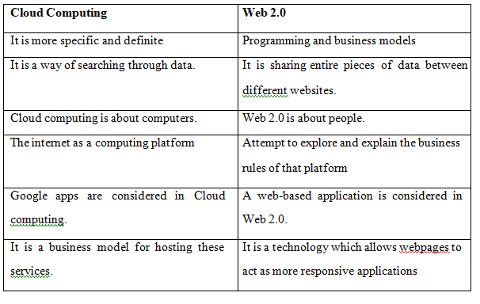
Difference: Cloud and Web 2.0

Slide 146
Optimal allocation of cloud models
The optimal allocation of computing resources is a core part for implementing cloud computing.
High heterogeneity, high dynamism, and virtualization make the optimal allocation problem more complex than the traditional scheduling problems in grid system or cloud computing system.

Slide 147
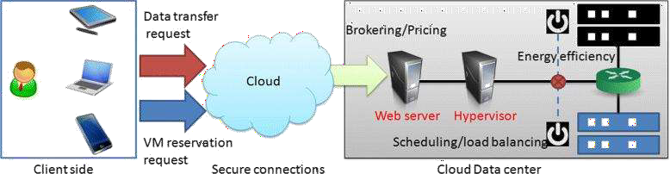
Optimal allocation of cloud models

Slide 148
Quiz
https://forms.gle/yCP92iUP4D2nFjaK6

Slide 149
Parallelization in Cloud Computing
Parallel computing is a type of computing architecture in which several processors execute or process an application or computation simultaneously.
Parallelization is the act of designing a computer program or system to process data in parallel. ... If a computer program or system is parallelized, it breaks a problem down into smaller pieces that can each independently be solved at the same time by discrete computing resources.

Slide 150
CLOUD ENABLING TECHNOLOGIES

Slide 151
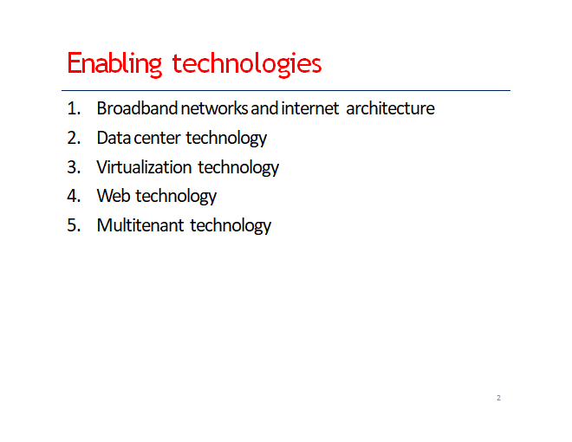

Slide 152
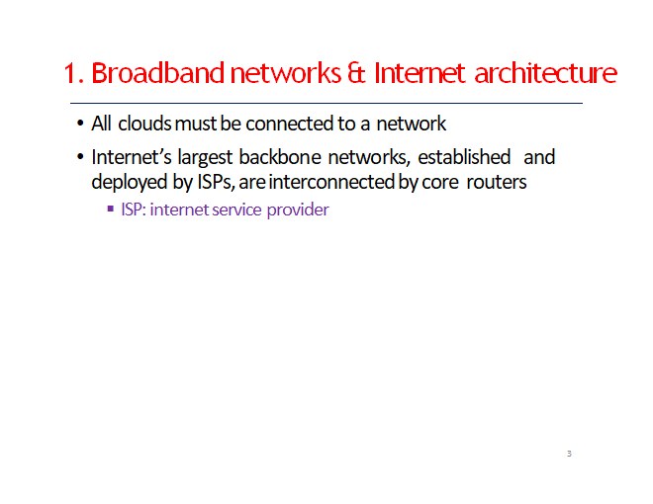

Slide 153
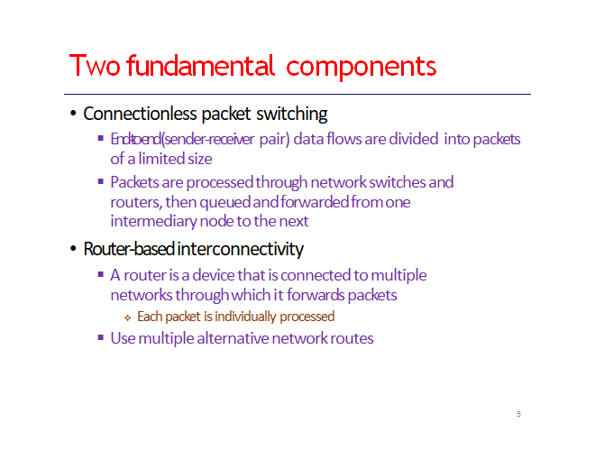

Slide 154
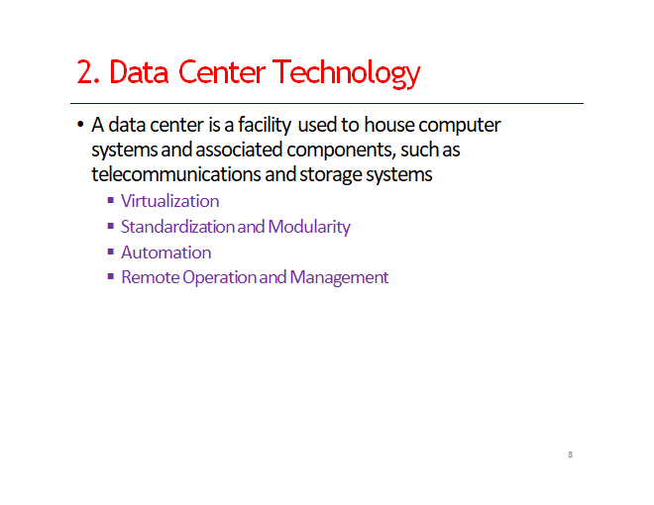

Slide 155
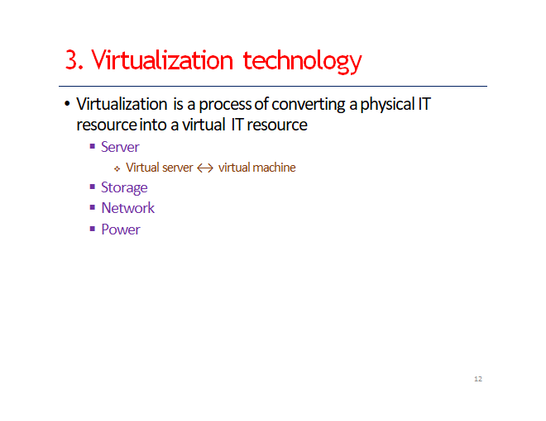

Slide 156
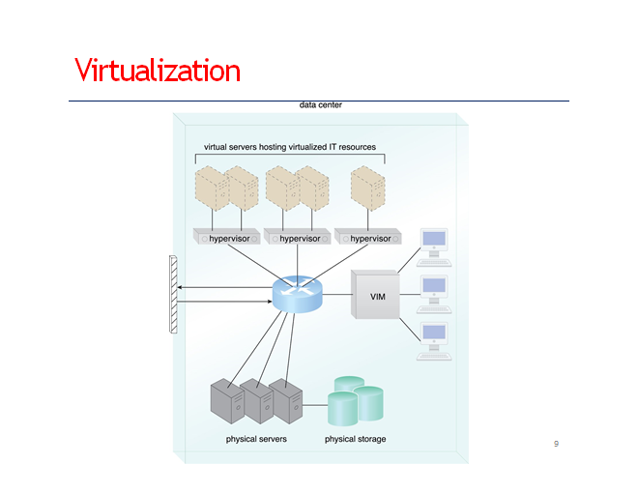

Slide 157
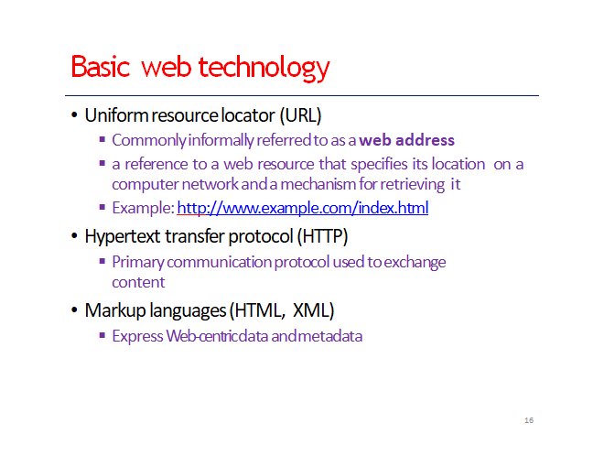

Slide 158
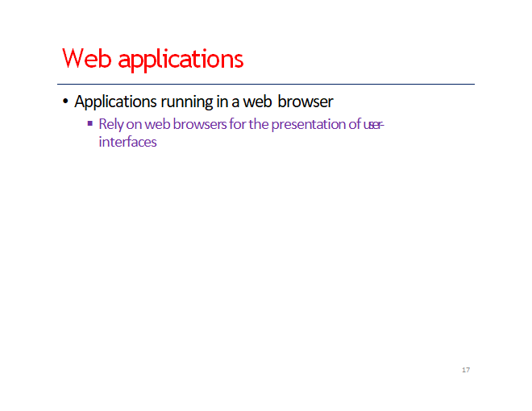

Slide 160
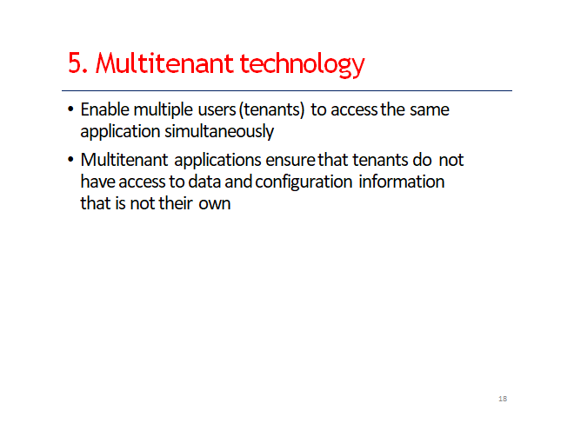

Slide 161
THANK YOU

